Slide 1
Code reviews have many layers like an onion, they also make you cry like an onion
https://dev.to/wyattdave
https://autoreview.powerdevbox.com

Slide 2





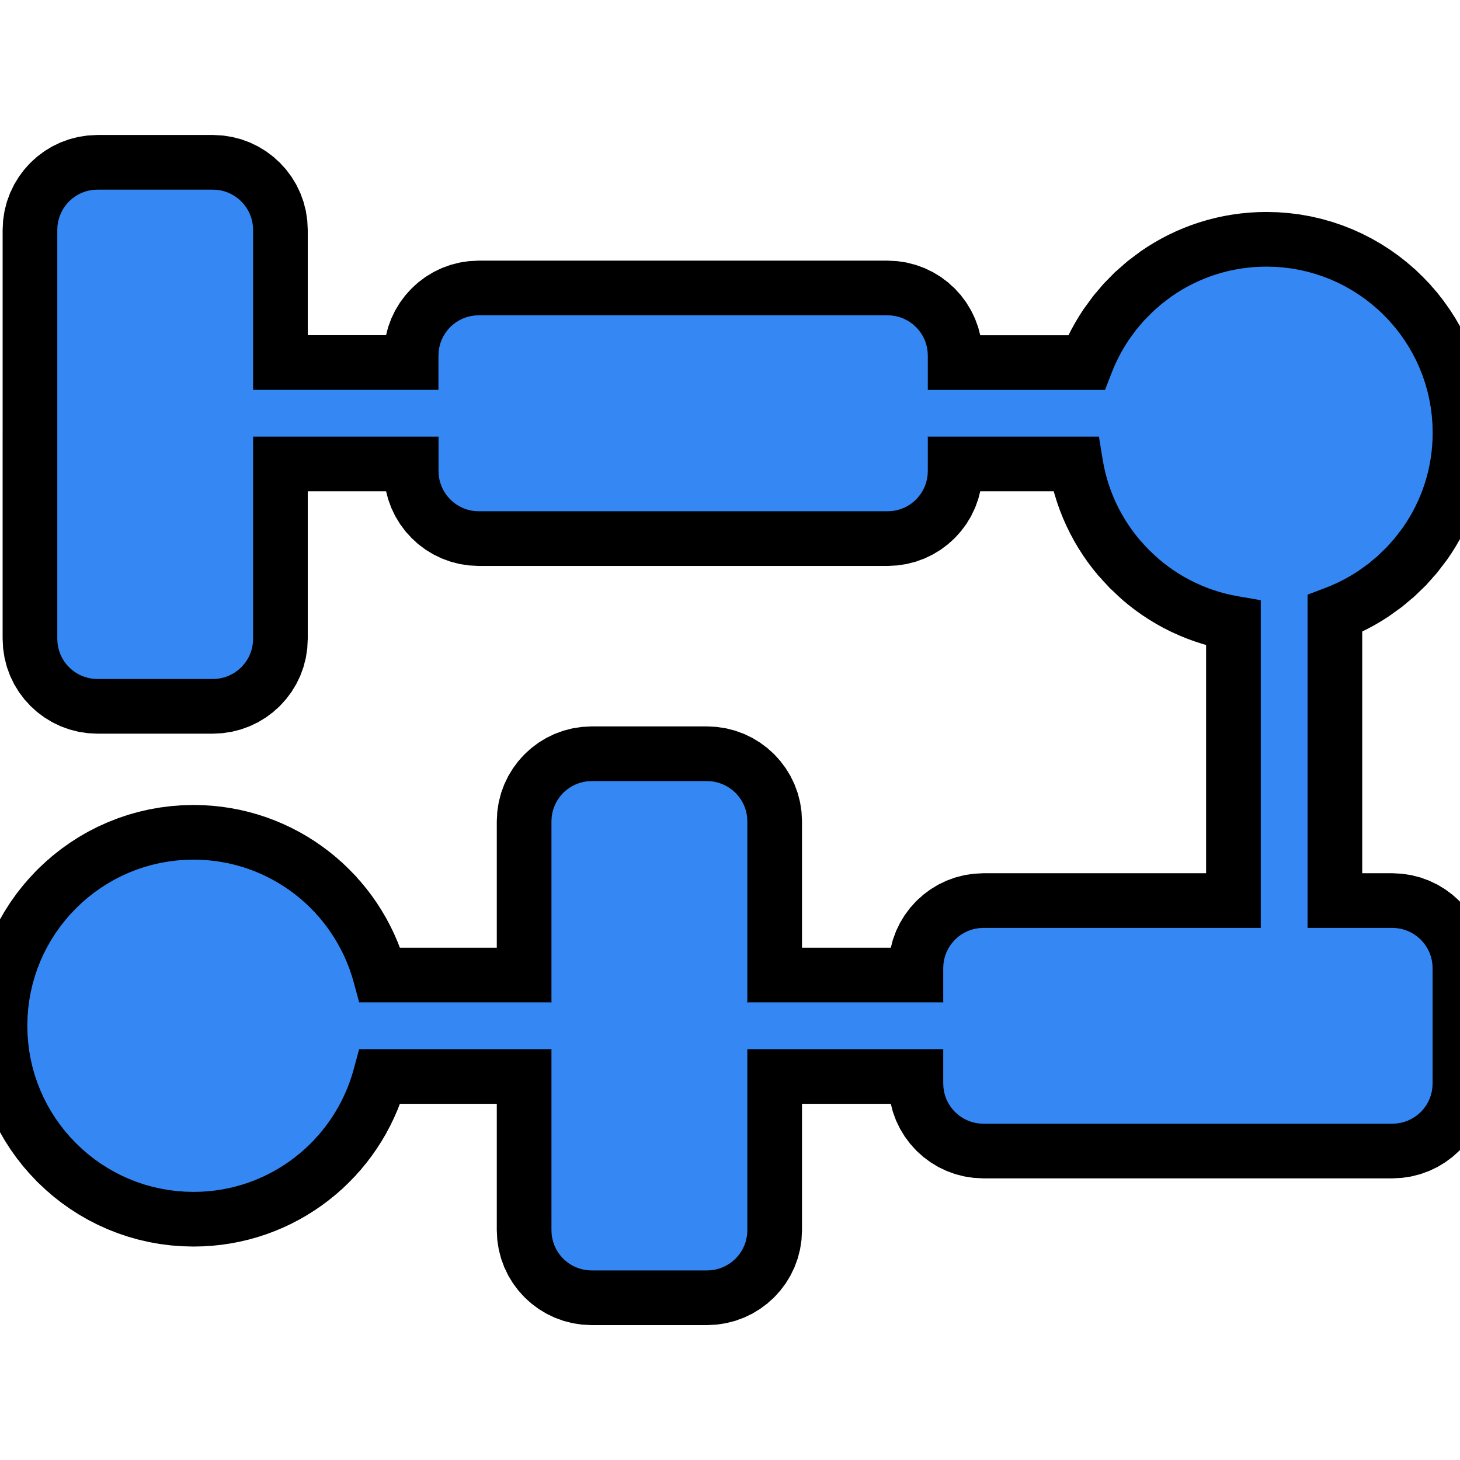
Power Automate - Code Review Onion
Solution & Contents
Connections
No missing dependencies
Environment var
Connection Ref
Flows
No hardcoded/environment var passwords/secrets
Environment vars for data sources
Object environment variables for groups of inputs
Secure inputs/outputs for all sensitive data ingress points
OneDrive/Excel by exception – use Dataverse/SharePoint
Trigger settings
Correct type of connection
List items settings
Exception Handling
Main and Exception Scope
RunAfter failed and timeout
Include failed run expression
Terminate failed in exception catch
Conversion file saves should exception handle to delete file
App called flows handle exception and pass back
Design
Naming standards for variables
Naming standards for actions
Variables/Composes - valid use case
Minimum nesting
Limit loops and contents
Environment variables for configurable values
Size/Complexity limits
https://dev.to/wyattdave
https://autoreview.powerdevbox.com

Slide 3
Solution & Contents
No missing dependencies
Can't import with them, only exceptions are Custom Connectors and Dataverse Tables
Environment variables
Should have for all data sources
SharePoint list should use the site variable
No Default values
If excessive then they should be using object variables
Connection References
Should be maximum one of each connection
Flows
Naming should explain what flow does and link to the solution
Not include
Custom Connectors and Dataverse tables should be in their own solutions
https://dev.to/wyattdave
https://autoreview.powerdevbox.com

Slide 4
Connections
No hardcoded passwords/secrets
Environment variables all for data sources except local Dataverse table
Object environment variables for groups of inputs
Secure inputs/outputs for all sensitive data ingress points
OneDrive/Excel by exception – use SharePoint/Dataverse
Trigger settings
No condition straight after run
Only run when needed
Correct type
Use business versions (Excel/OneDrive/Outlook)
Use HTTP versions by exception
List items
Pagination and threshold on
Query filter where possible
https://dev.to/wyattdave
https://autoreview.powerdevbox.com

Slide 5
Exception Handling
Main and Exception Scope
This is required for a catch all errors approach
RunAfter failed and timeout
Exception handling runs on failed and should also be timeout
Always have a failed terminate in exception handling to flag failed run in the logs
Include failed run expression & link
Result() expression and filter or Xpath() expression
Use expression to construct run url so that IACS can find failed run
Saving to OneDrive exception handle delete file
Conversion file saves should exception handle to delete file
App called flows handle exception and pass back
App called flows should handle exception and pass back to app to handle the exception
Same with Child flows and parent flows
https://dev.to/wyattdave
https://autoreview.powerdevbox.com

Slide 6
Design
Naming standards for variables
Ideally TJX - sString, bBoolean, iInteger, oObject, aArray
Naming standards for actions
Keep action name and add description of what it does
Variables/Composes - valid use case
All inputs are global so variables are not needed for data storage
Composes use api calls so should be avoided
Don’t set variables with a Condition, use expression
Minimum nesting
High nesting impacts ui making it hard to edit/read flows
Environment variables for configurable values
If configurable should be in environment variable e.g. email addresses and email bodies
Limit loops
Avoid loops within loops
User filter not loop with condition inside
Move non loop items out of loop e.g. get template
Use first() or [0] for single row returns
Size/Complexity limits
Overly complex/long flows should be broken into multiple flows
https://autoreview.powerdevbox.com

